Slide 1

Hardware/Software Co-Verification Using Specman and SystemC with TLM Ports
by
Horace Chan
Verification Lead
PMC-Sierra, Inc.

Slide 2
Overview
Introduction
Generic Embedded SoC Testbench Architecture
Existing Co-verification Methods
Specman to SystemC TLM Software Bridge
  Overview
  TLM port and data structure
  Specman to C software function calls
  C to Specman system methods calls
Advantage and Benefits
Challenges and Future Development
Q & A
Horace Chan, PMC-Sierra, Inc.
<number> of 9

Slide 3
Introduction
Co-verification benefits
  Gives software engineer early access to the hardware
  Provides additional testing for the hardware design
  Provides better visibility in debugging software and hardware interaction
Provides an integrated hardware and software solution
Shortens the overall project schedule
Horace Chan, PMC-Sierra, Inc
<number> of 9

Slide 4
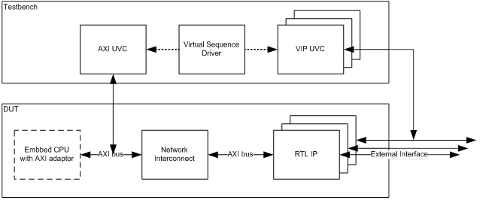
Generic Embbed SoC Testbench Architecture
Specman Testbench with UVM
  How to call C functions from the testbench?
  How to initiate AXI transactions from C functions?
  How to the check the expected behavior of RTL IP?
Horace Chan, PMC-Sierra, Inc.
<number> of 9

Slide 5
Existing Co-Verification Methods
Acceleration/Emulation
  Very Expensive
  Hard to reuse existing testbench components
ISX/ISS
  Require extra license
  Slow execution speed
Socket/CVL
  Testbench has to relinquish control to the software
  C code cannot access internal data structure of the testbench
Horace Chan, PMC-Sierra, Inc
<number> of 9

Slide 6
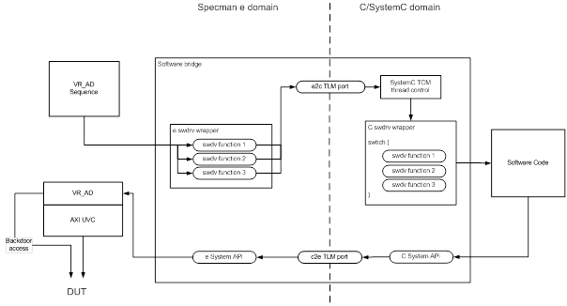
Specman to SystemC TLM Software Bridge
Horace Chan, PMC-Sierra, Inc.
<number> of 9

Slide 7
TLM port and data structure
Sample software function
TLM port data structure
TLM port declaration
Function arguments data structure
int foo(int arg1, arg2);
Extend func_name_t : [foo]
struct foo_arg_s {
arg1 : int;
arg2 : int;
return_value : int;
};
struct func_calls_s {
func : func_name;
arg_ptr : uint;
};
e2c : out interface_port of tlm_blocking_put_if
of (func_call_s) is instance;
c2e : in interface_port of tlm_blocking_put_if
of (func_call_s) is instance;
Horace Chan, PMC-Sierra, Inc.
<number> of 9

Slide 8
Specman to C software function Call
foo(arg1 : int, arg2 : int) : int @sys.any is {
var foo_arg : foo_arg_s = new with {
.arg1 = arg1;
.arg2 = arg2;
};
var func_call : func_call_s = new with {
.func = foo;
.arg_ptr = foo_arg.get_pointer();
};
e2c$.put(func_call);
return foo_arg.return_value;
};
e Wrapper
C Wrapper
switch (func_call->func) {
case SN_ENUM(func_name_t, foo) :
SN_TYPE(foo_arg_s) arg = (SN_TYPE(foo_arg_s))
func_call->arg_ptr;
arg->return_value = foo(arg->arg1,arg->arg2);
break;
Horace Chan, PMC-Sierra, Inc.
<number> of 9

Slide 9
C to Specman system methods calls
Intercept system read/write options in C functions
Hook up system functions call to VR_AD sequences in Specman side
Use Doxygen to auto-generate the wrappers
int sys_read(int addr){
func_call_s func_call;
SN_TYPE(sys_read_arg_s) sys_read_arg = new;
sys_read_arg->addr = addr;
func_call.func = sys_read;
func_call.arg_ptr = &sys_read_arg;
c2e->put(func_call);
return sys_read_arg->return_value;
};
Horace Chan, PMC-Sierra, Inc.
<number> of 9

Slide 10
Advantage and Benefits
FREE!!!
Fast execution speed
  The C code is running on the Linux host
Easy debug support
  Simvision SystemC debugger (gdb)
  Simvision stripe chart
Scalarable
  Swap the SystemC with ISX using WHEN subtype
Coverage for software calls
  Define coverage item on the argument data structure
Horace Chan, PMC-Sierra, Inc
<number> of 9

Slide 11
Challenges and Future Development
Pointer errors in C code
  Simulator and software running in same memory space
  Segmentation fault can bring down the simulator
Debug turn around time
  SystemC code is statically linked into RTL snapshot
  Enhance the bridge to use dynamically loaded shared library
System Verilog Support
Horace Chan, PMC-Sierra, Inc
<number> of 9

Slide 12
Q & A
Question and Answer
<your_name>, <your_company>
<number> of 9

